Slide 1

Kinodynamic RRTs with Fixed Time Step and Best-Input Extension
Are Not Probabilistically Complete
Tobias Kunz, Mike Stilman

Slide 2
“This algorithm is proven to be complete in the probabilistic sense.”
– Goerzen et al., Journal of Intelligent and Robotic Systems, 2010
“Under appropriate technical conditions, the RRT algorithm has been proven probabilistically complete.”
– Frazzoli et al., Journal of Guidance, Control, and Dynamics, 2002
“It has been shown that, for a controllable system, the RRT will ultimately cover the entire state space as the number of sample points goes to infinity.”
– Esposito et al., WAFR, 2004
“Randomized approaches are understood to be probabilistically complete.”
– Zucker et al., Int. Journal of Robotics Research, 2010

Slide 3
Not all RRTs are probabilistically complete.

Slide 4
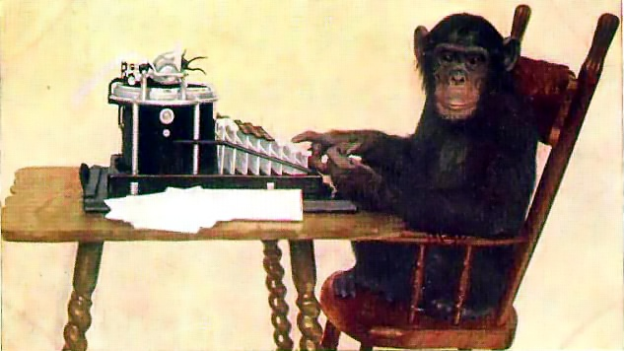
Probabilistic Completeness
The probability that an existing solution is found converges to 1 as the number of iterations grows to infinity.

Slide 5
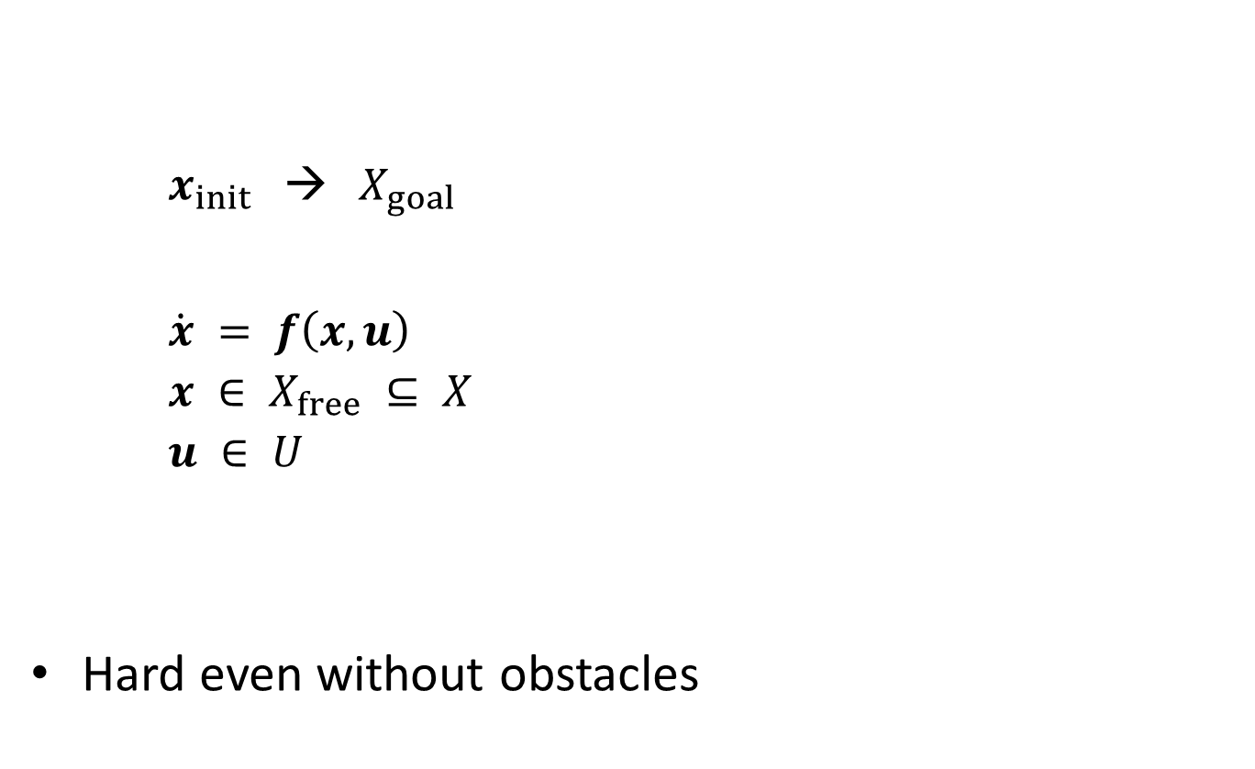
Problem Definition
  $x_{init}$ → $X_{goal}$
  $\dot{x} = f\left(x,u\right)$
  $x ∈ X_{free} ⊆ X$
  $u ∈ U$
Hard even without obstacles

Slide 6
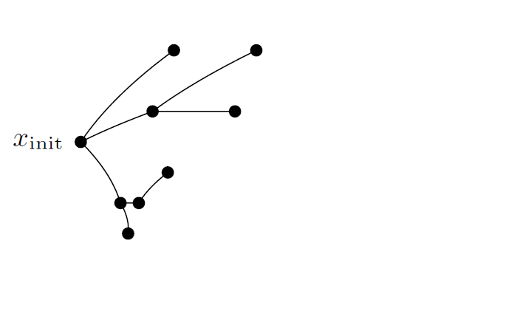
Kinodynamic RRT Algorithm
[LaValle & Kuffner]

Slide 7
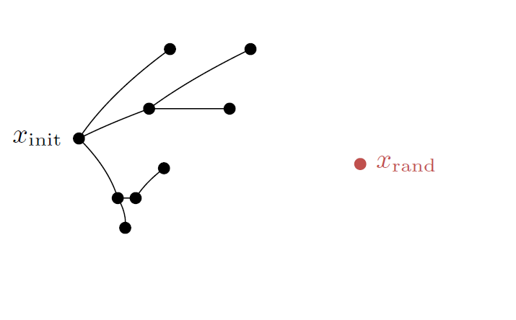
Kinodynamic RRT Algorithm
[LaValle & Kuffner]
1. Sample the state space

Slide 8
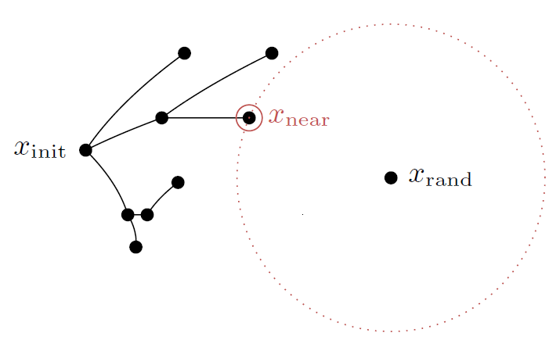
Kinodynamic RRT Algorithm
[LaValle & Kuffner]
2. Select nearest node

Slide 9
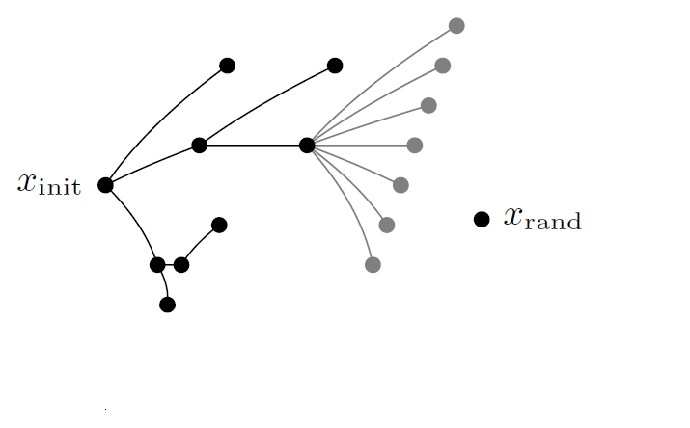
Kinodynamic RRT Algorithm
[LaValle & Kuffner]
3. Expand tree from selected node
  Time step: fixed or variable
  Control input: random or best

Slide 10
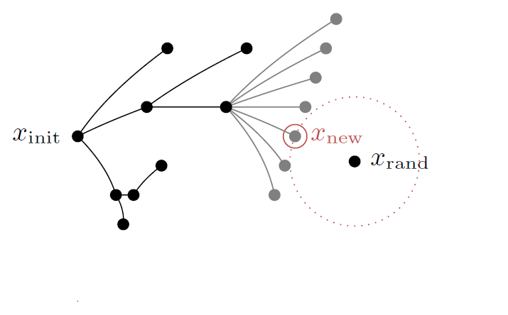
Kinodynamic RRT Algorithm
[LaValle & Kuffner]
3. Expand tree from selected node
  Time step: fixed or variable
  Control input: random or best

Slide 11
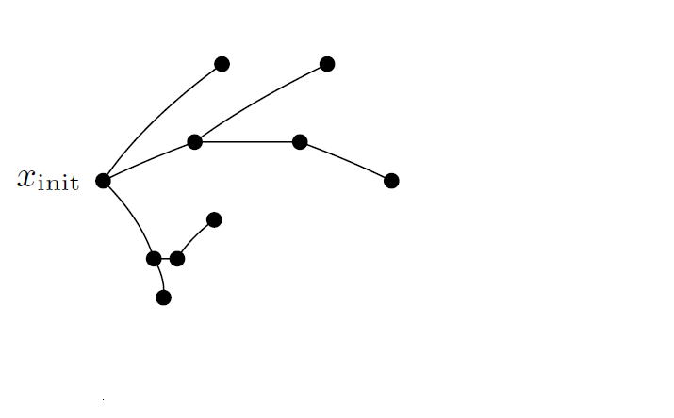
Kinodynamic RRT Algorithm
[LaValle & Kuffner]

Slide 12
Kinodynamic RRT Variants
 | Fixed time step | Variable time step
Random input | - | -
Best input | Commonly used | -
Cheng & LaValle, ICRA 2002
Bhatia & Frazzoli, 2004
Esposito et al., WAFR 2004
Petti & Fraichard, IROS 2005
Kalisiak & van de Panne, ICRA 2006
Glassman & Tedrake, ICRA 2010
OMPL

Slide 13
Probabilistic Completeness of Kinodynamic RRTs
 | Fixed time step | Variable time step
Random input | Probabilistically complete [LaValle & Kuffner, 2000] | ?
Best input | ? | ?

Slide 14
Probabilistic Completeness of Kinodynamic RRTs
 | Fixed time step | Variable time step
Random input | Probabilistically complete [LaValle & Kuffner, 2000] | ?
Best input | Not probabilistically complete [this work] | ?

Slide 15
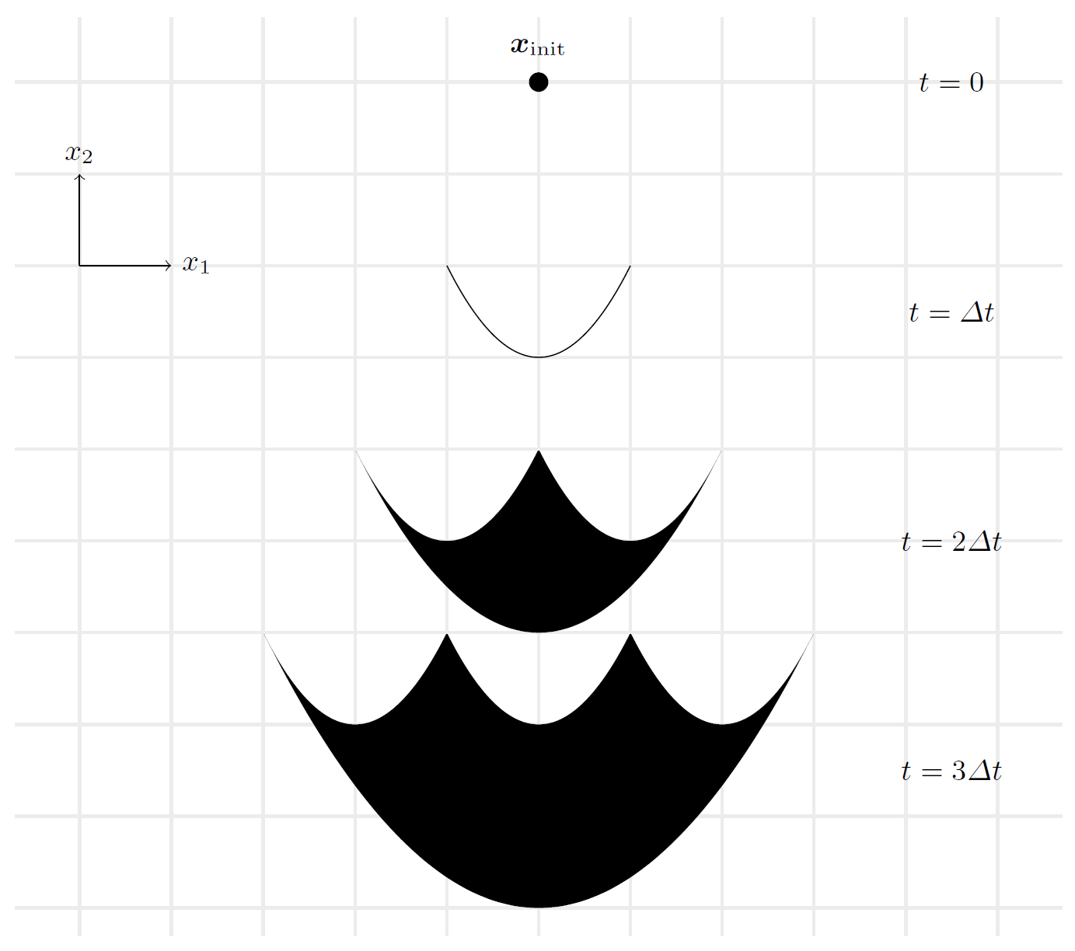
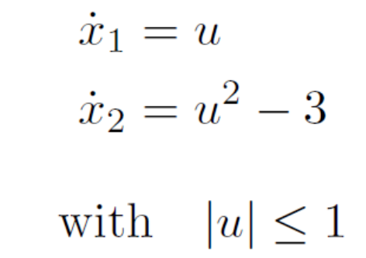
Proof
Counter example
  No obstacles
  Euclidean distance

Slide 16
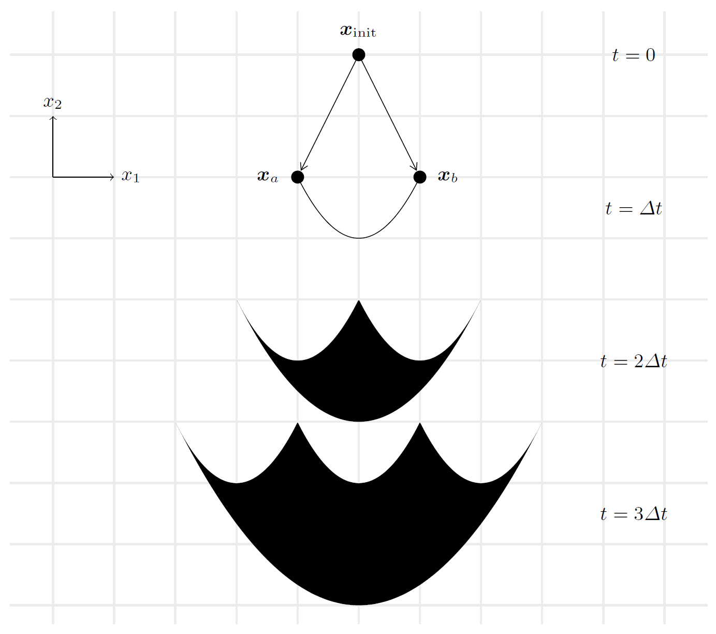
Proof
Intermediate Tree

Slide 17
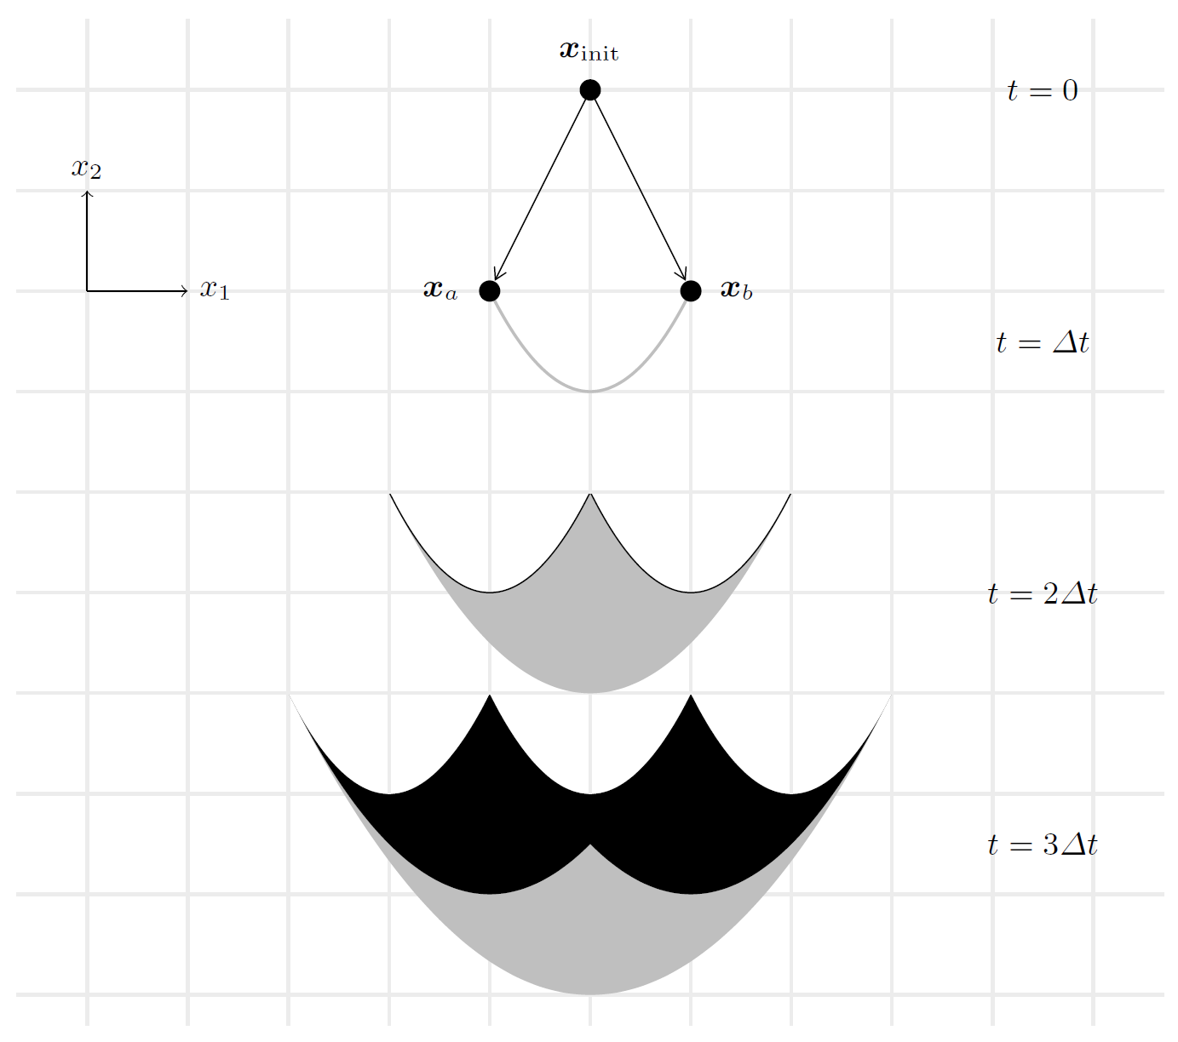
Proof
Intermediate Tree

Slide 18
Proof

Slide 19
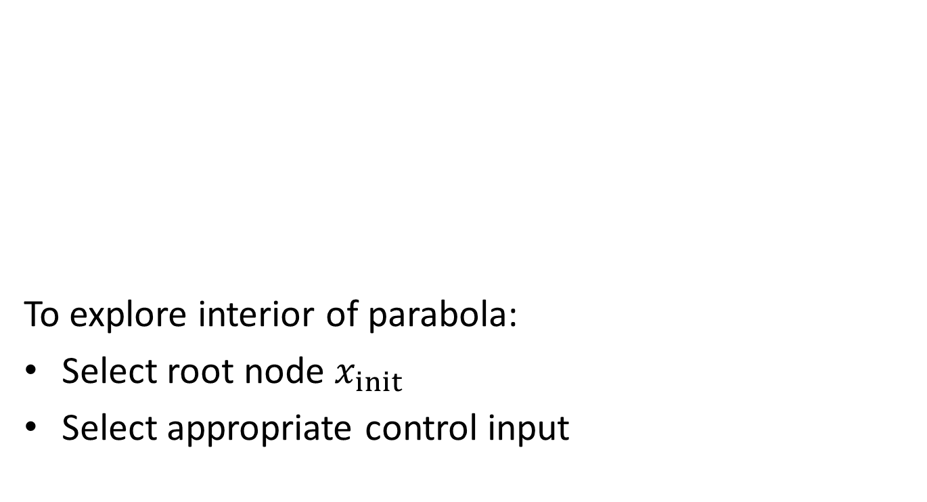
Proof
To explore interior of parabola:
Select root node $x_{init}$
Select appropriate control input

Slide 20
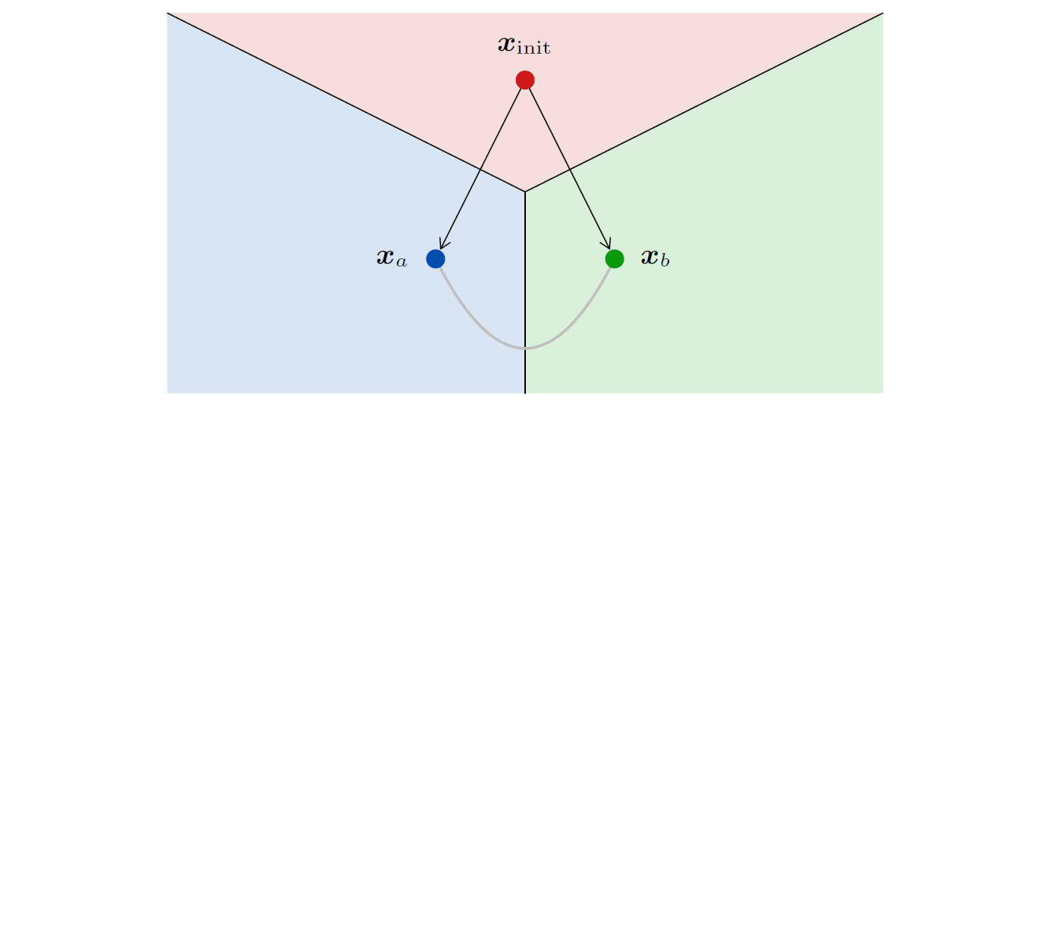
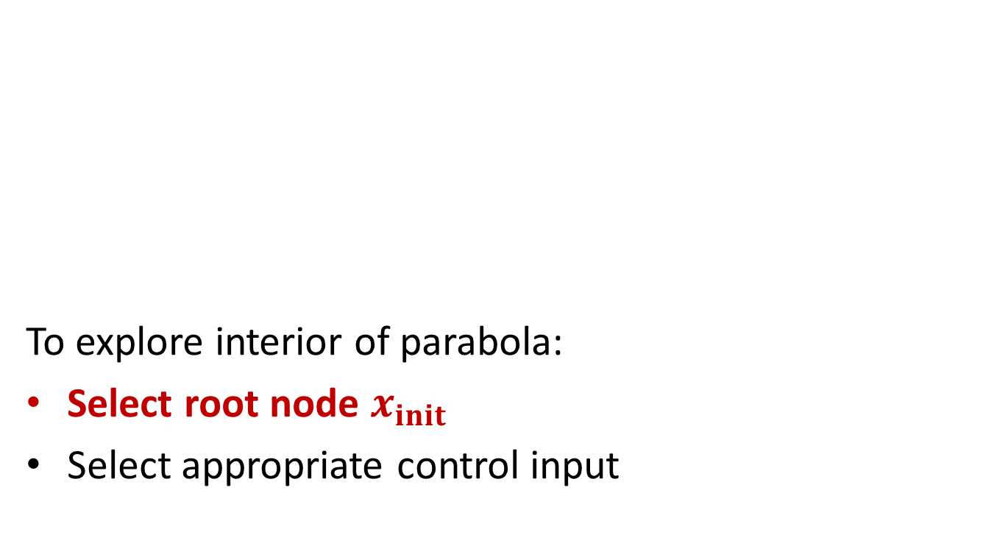
Proof
To explore interior of parabola:
Select root node $x_{init}$
Select appropriate control input

Slide 21
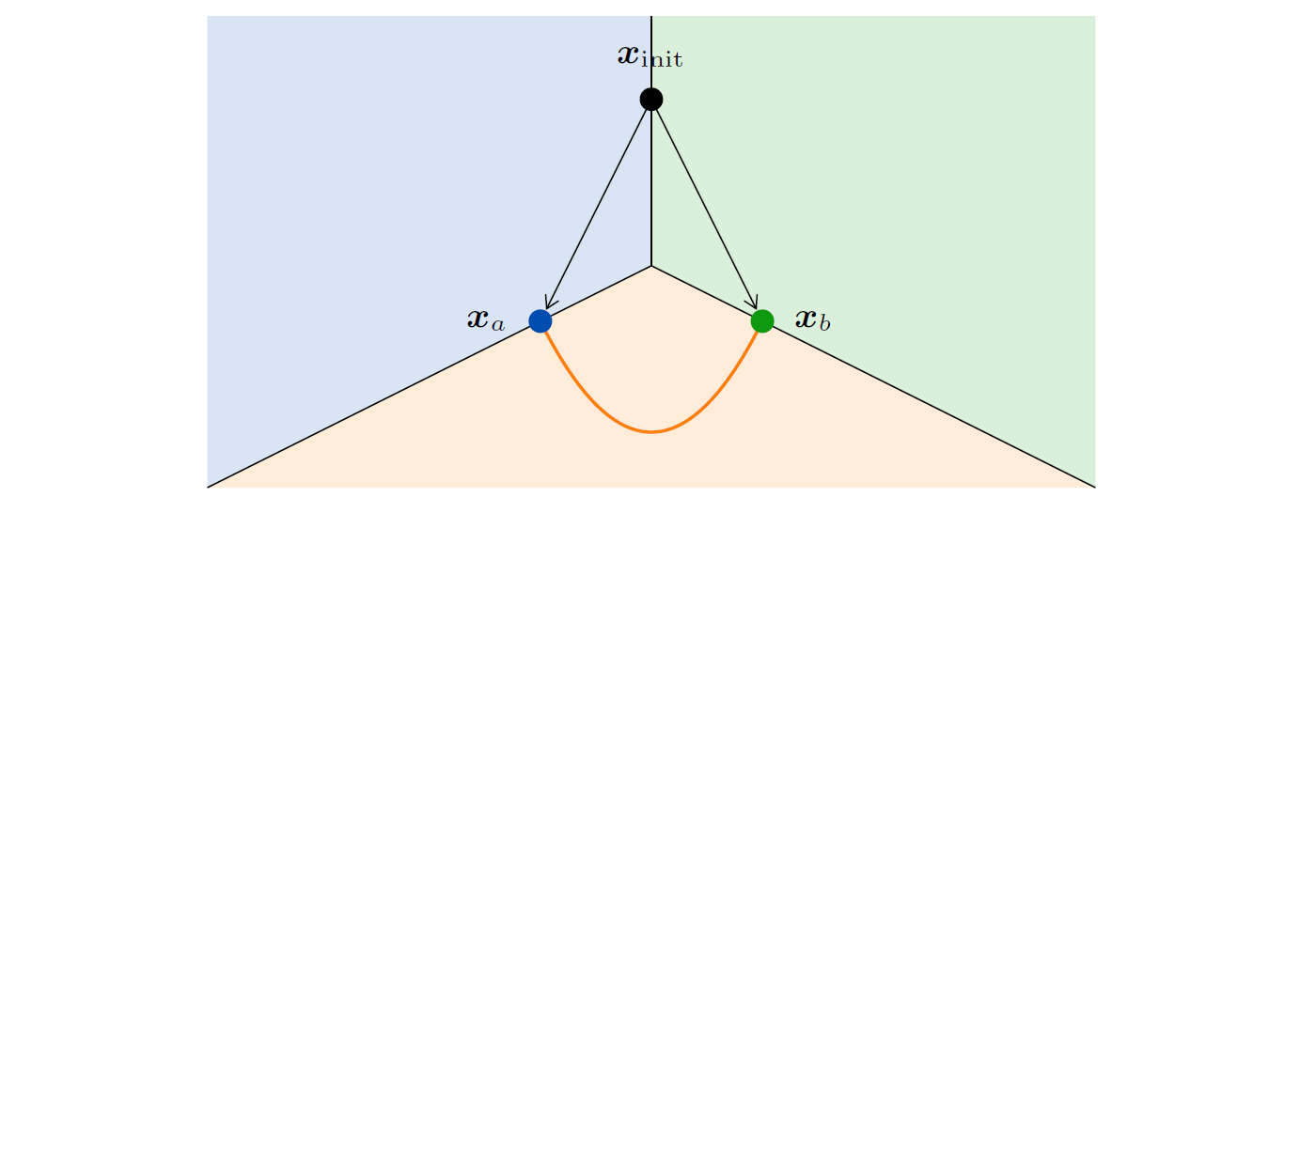
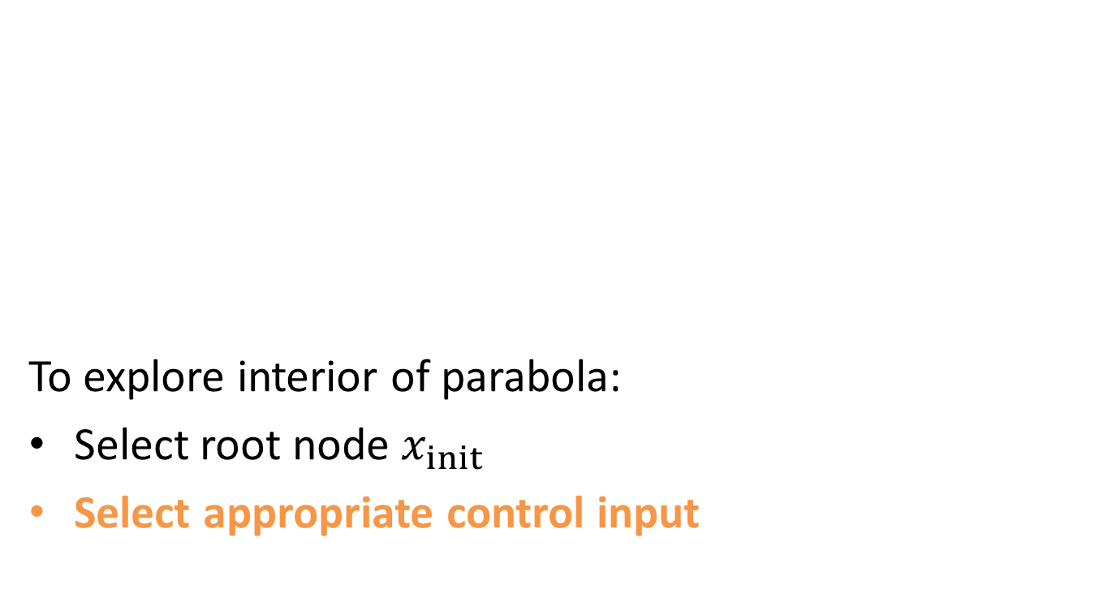
Proof
To explore interior of parabola:
Select root node $x_{init}$
Select appropriate control input

Slide 22
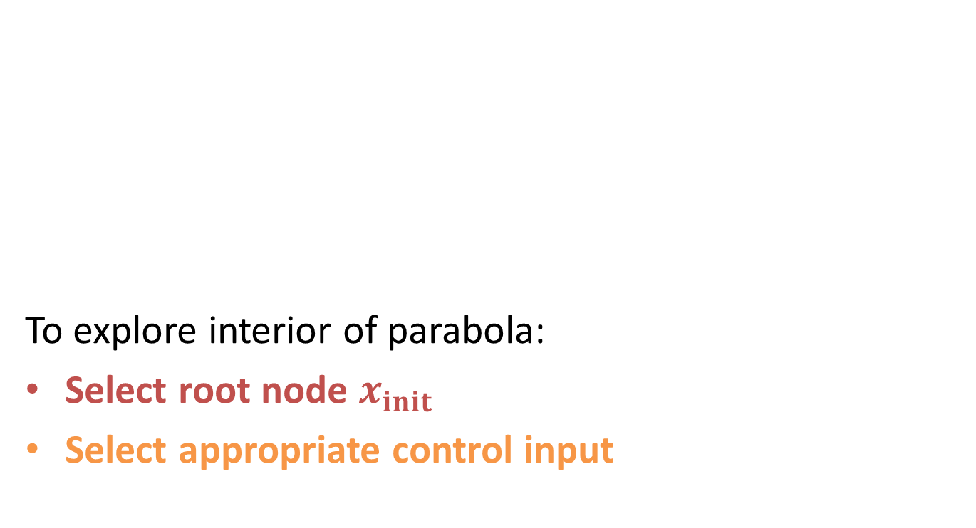
Proof
To explore interior of parabola:
Select root node $x_{init}$
Select appropriate control input

Slide 23
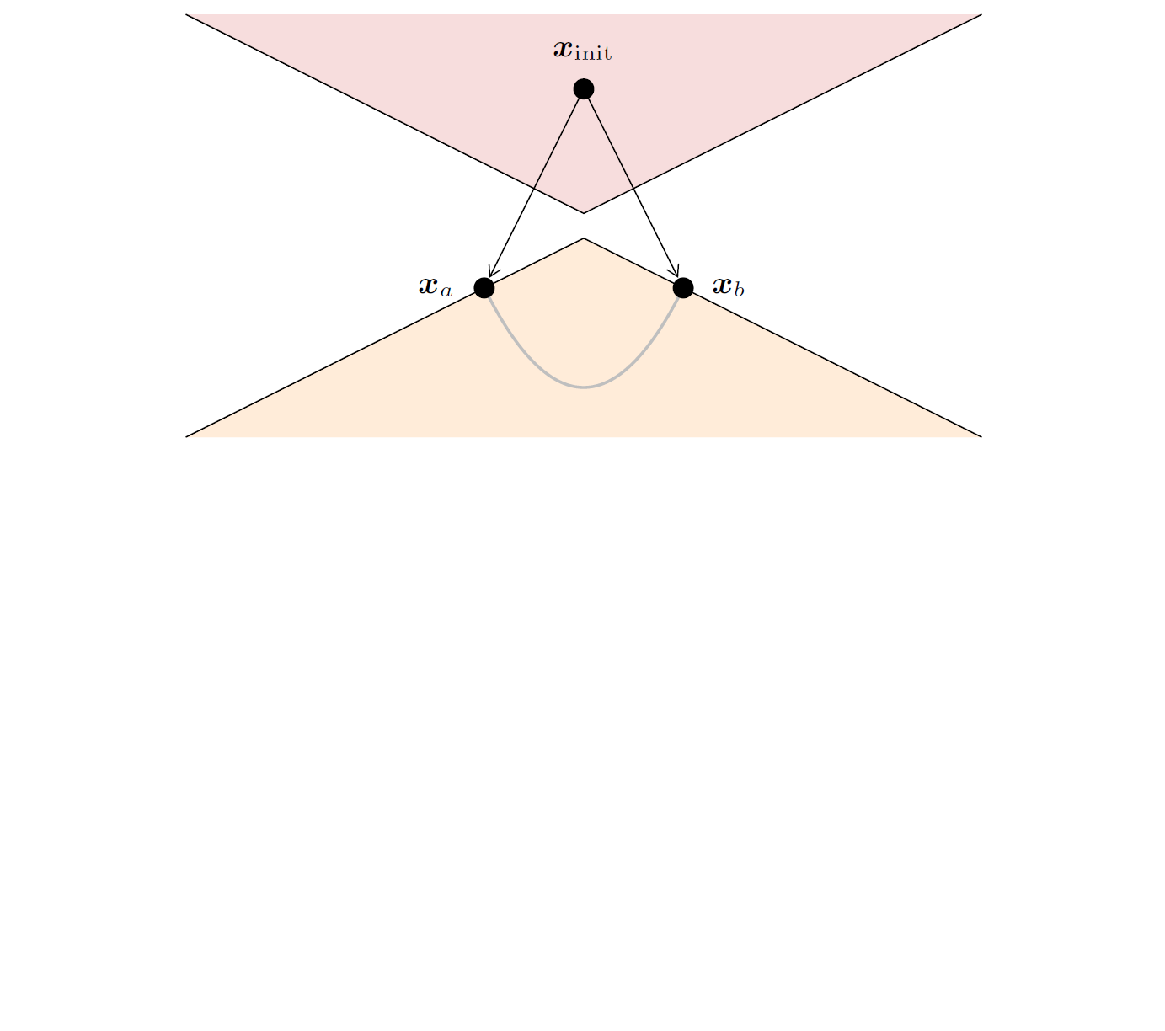
Proof

Slide 24

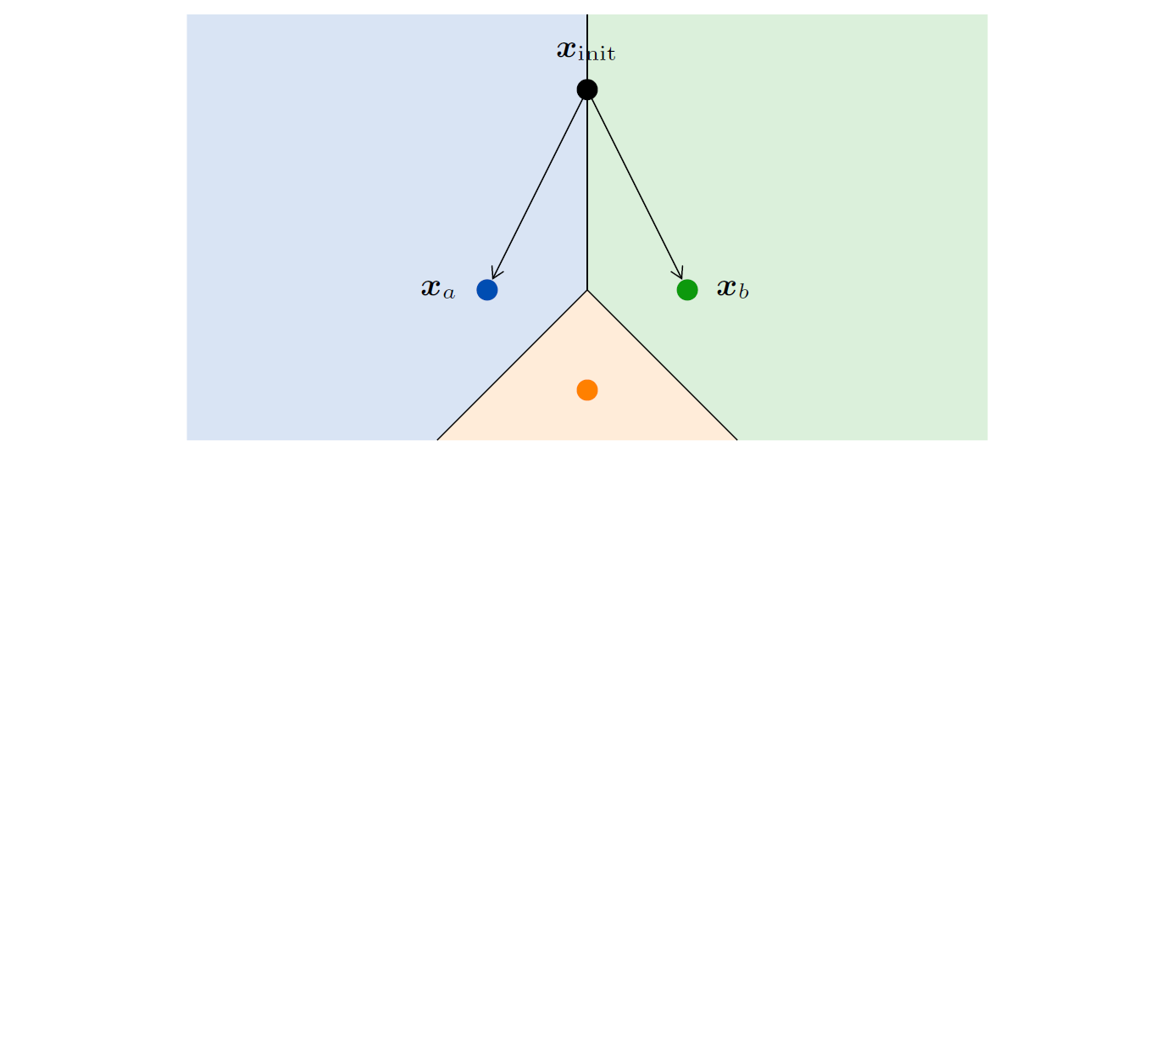
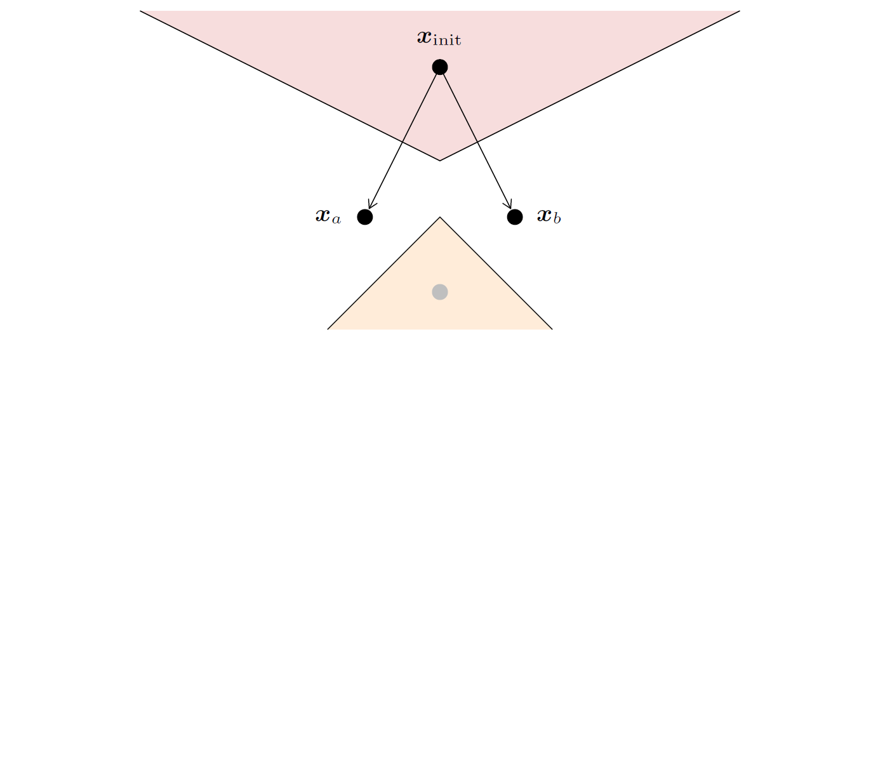
Discrete Input

Slide 25
Future Work
Requirements for probabilistic completeness
 | Fixed time step | Variable time step
Random input | Probabilistically complete [LaValle & Kuffner, 2000] | ?
Best input | Not probabilistically complete [this work] | ?

Slide 26
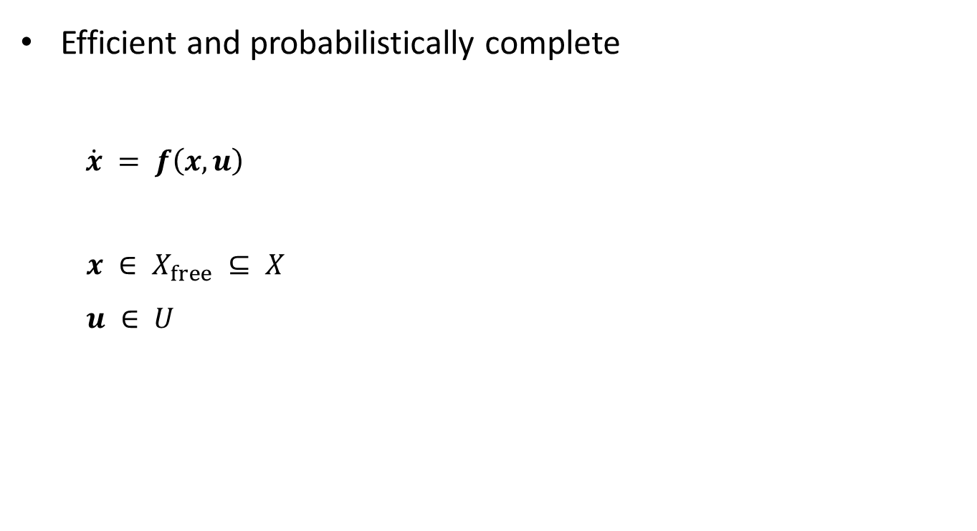
RRTs with Steering Methods
[IROS 2014]
  Efficient and probabilistically complete
  $$\dot{x} = f\left(x,u\right)$$
  $x ∈ X_{free} ⊆ X$
  $u ∈ U$
Available for:
Geometric planning
Double integrators
Linear-quadratic problems
Dubins car
Reeds-Shepp car

Slide 27
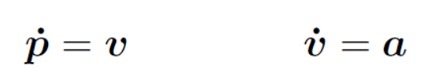
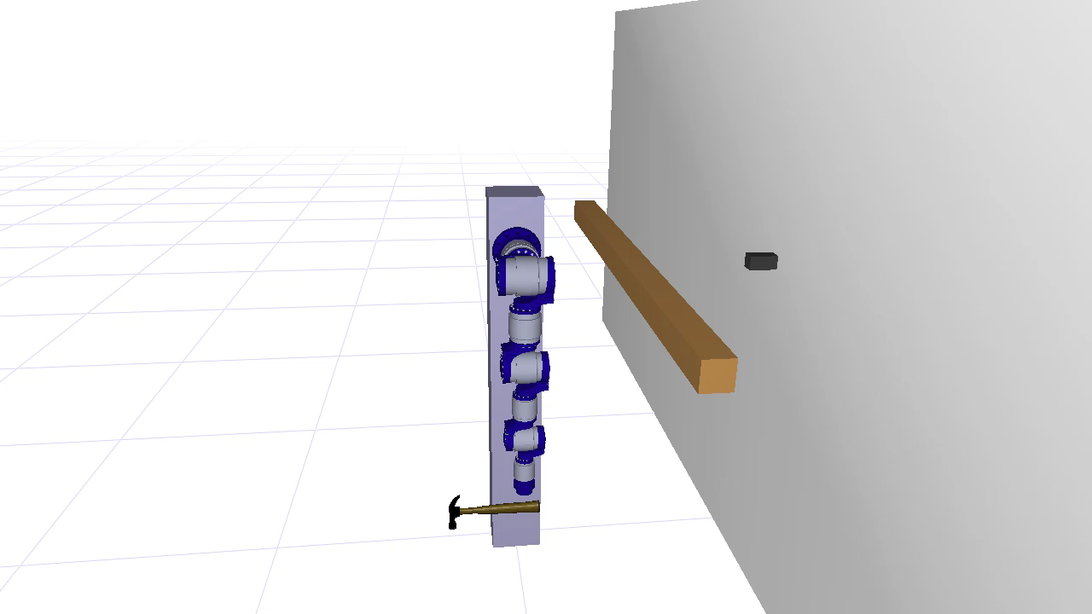
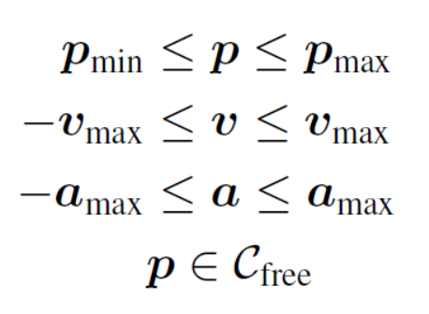
RRTs with Steering Methods
[IROS 2014]
 | Kinodynamic RRT | Steered RRT
# nodes | > 1,000,000 | 14.6
# samples | > 900,000 | 434.1
Time | > 8 hours | 37 ms
Averages over 100 runs

Slide 28
Conclusion
Most common Kinodynamic RRT variant not probabilistically complete in general
More research necessary on conditions for probabilistic completeness
Alternatively: Use steering methods

